Slide 1

Introduction to partitioning

Slide 2
Partitioning definition
Splitting a table horizontally into different units
Units can be spread across different physical locations
Primarily for maintenance of data
Query performance may be improved

Slide 3
Partitioning Concepts
Partition Functions
Partition Schemes
Aligned & Non-aligned indexes
Splitting, merging & switching partitions

Slide 4
Partitioning key
Column in the table which defines partition boundaries
How is the data going to be split?
Archiving/retention policy for the data?
How is the table going to be queried?

Slide 5
Partition Functions
Maps rows in the table to a partition CREATE PARTITION FUNCTION [NAME](DATATYPE) AS RANGE RIGHT | LEFT FOR VALUES (n,n1,n2...nx);

Slide 6
Left / Right Range Types
Defines partition boundaries Right 2016-03-11 00:00:00 <= x < 2016-03-12 00:00:00 Left 2016-03-11 00:00:00 < x <= 2016-03-12 00:00:00

Slide 7
Partition Schemes
Maps partitions to filegroups CREATE PARTITION SCHEME [NAME] AS PARTITION [FUNCTION NAME] [ALL] TO (FILEGROUP,FILEGROUP,FILEGROUP...);

Slide 8
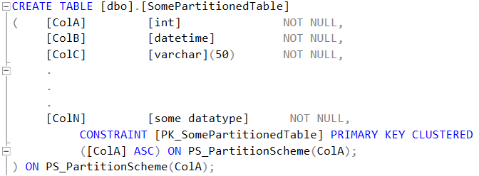
Creating a partitioned table

Slide 9
Nonclustered indexes
An index that is created using the same partition scheme as the base table is aligned An index that is created on a different filegroup or using a different partition scheme is non-aligned

Slide 10
Splitting partitions
Creates a new partition ALTER PARTITION SCHEME [NAME] NEXT USED [FILEGROUP]; ALTER PARTITION FUNCTION [NAME]() SPLIT RANGE (VALUE);

Slide 11
Merging Partitions
Removes a partition ALTER PARTITION FUNCTION [NAME]() MERGE RANGE (VALUE);

Slide 12
Switching partitions
Move a partition from one table to another ALTER TABLE [Source Table] SWITCH PARTITION Partition_Number TO [Destination Table] PARTITION Partition_Number;

Slide 13
Demo

